Slide 1
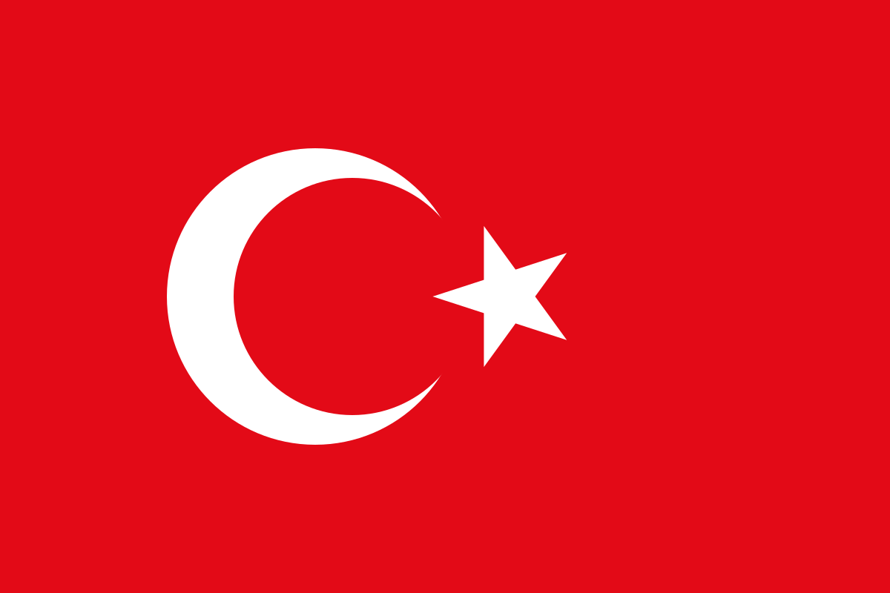
TURKEY
This Photo by Unknown author is licensed under CC BY-NC-ND.
RANA ESRA KESKIN
This Photo by Unknown Author is licensed under CC BY-SA

Slide 2
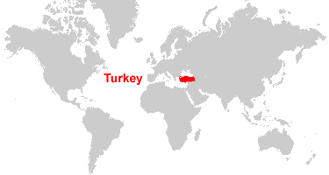
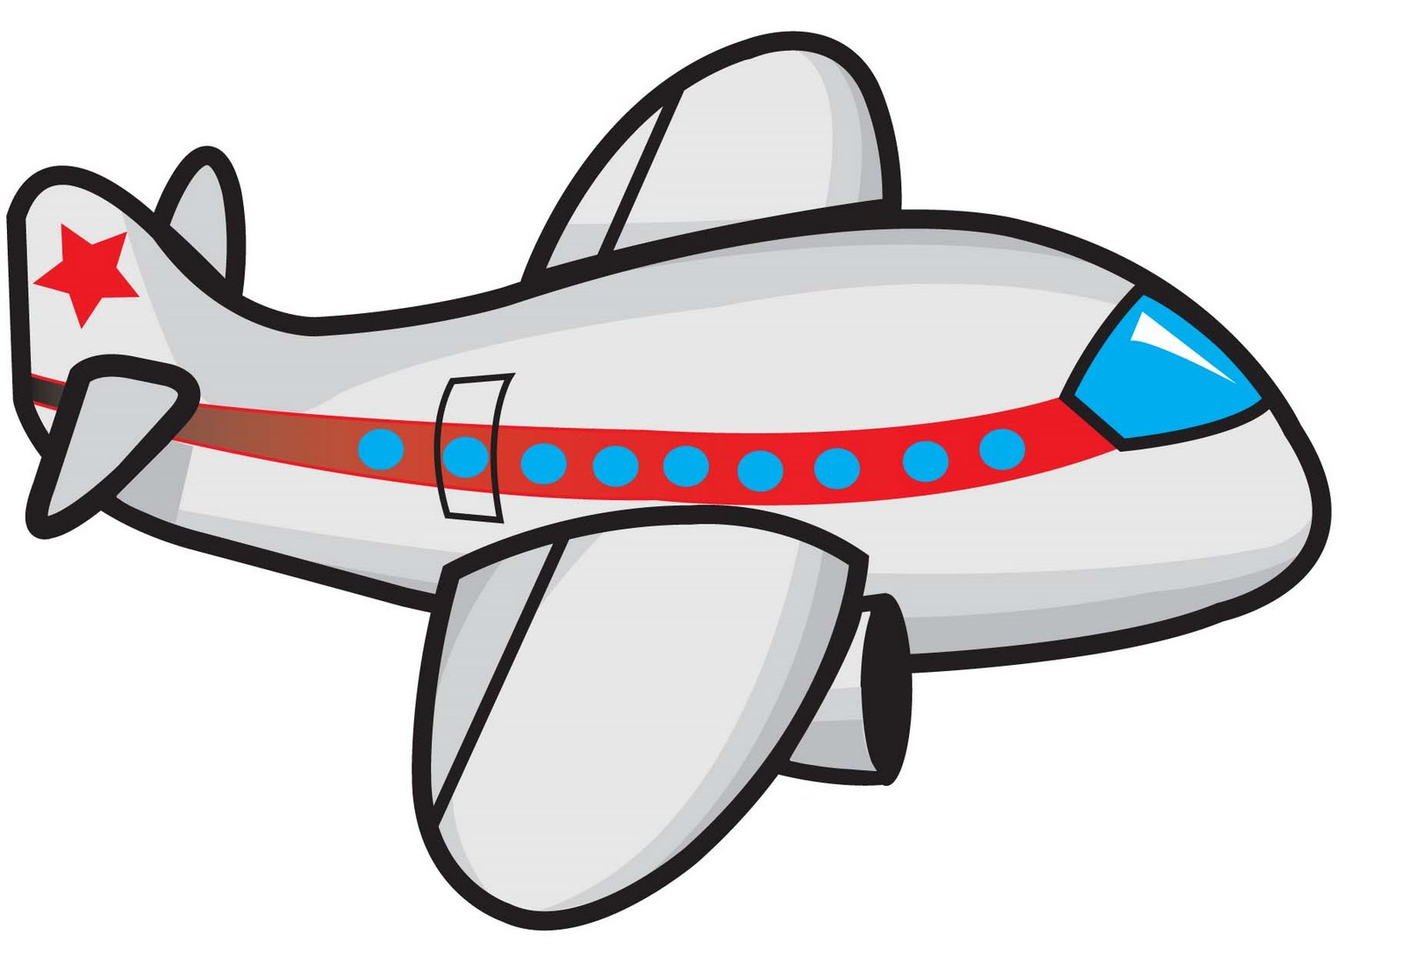
Where is Turkey?
v

Slide 3
What language do we talk in Turkey?
We talk Turkish in Turkey. We use Latin alphabet.
"Hello" means "Merhaba", "bye" means "gule gule"
If you go to Turkey, you can talk like this:
merhaba benim adim…that means my name is …[you need to say your name in this …like benim adim Rana]

Slide 4
Who are the neighbors of Turkey?
Bulgaria
Greece
Georgia
Armenia
Azerbaijan
Iran
Iraq
Syria
This Photo by Unknown author is licensed under CC BY-SA.

Slide 5
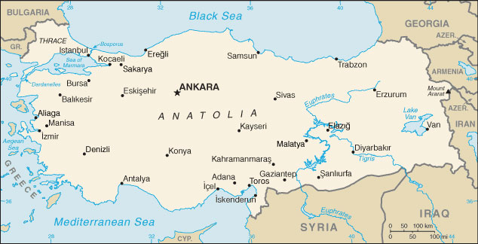
Fun facts
Turkey is two continents, Asia and Europe
Turkish people introduce coffee to Europe.

Slide 6
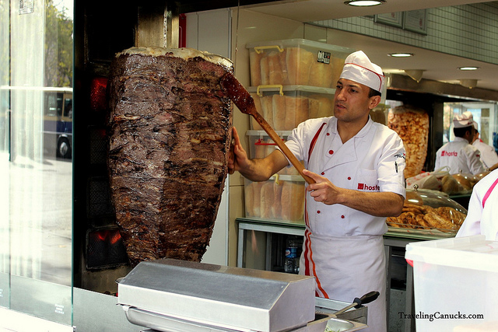
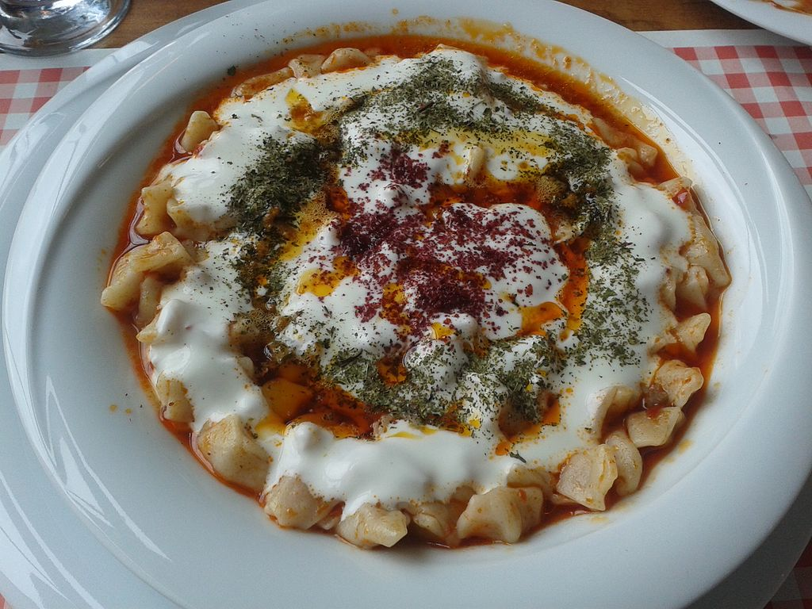
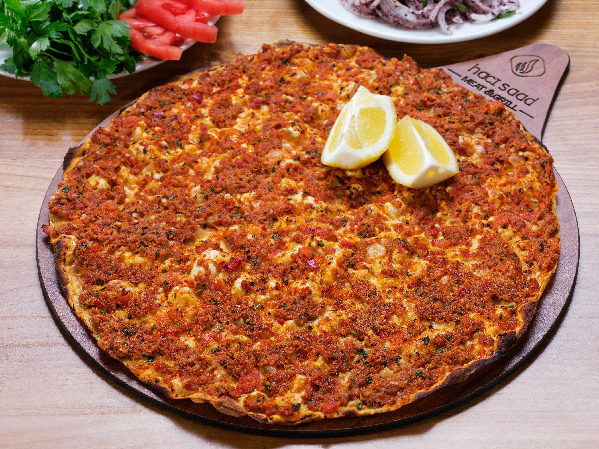
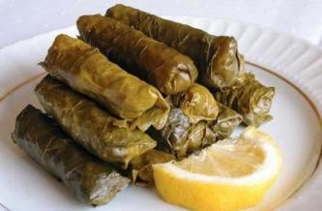
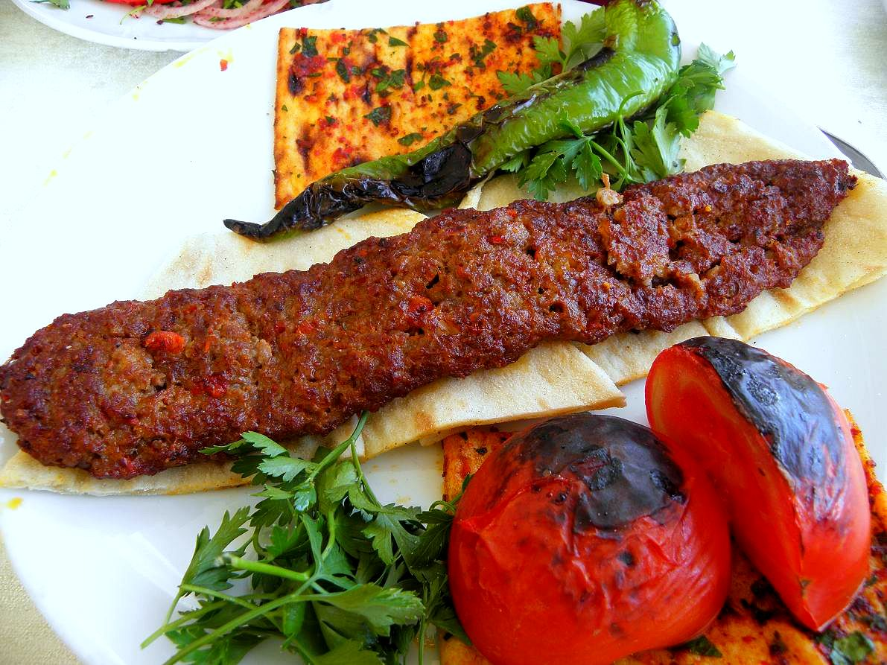
Foods
Doner
Kebap
Lahmacun
Pide
Iskender
Manti
Dolma
Tarhana
Mercimek koftesi
Cig Kofte
...

Slide 7
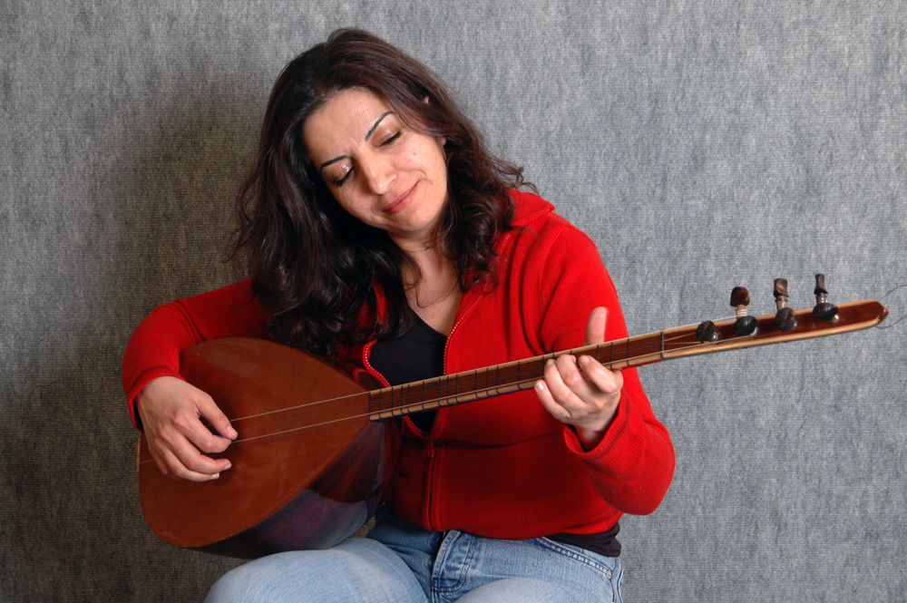
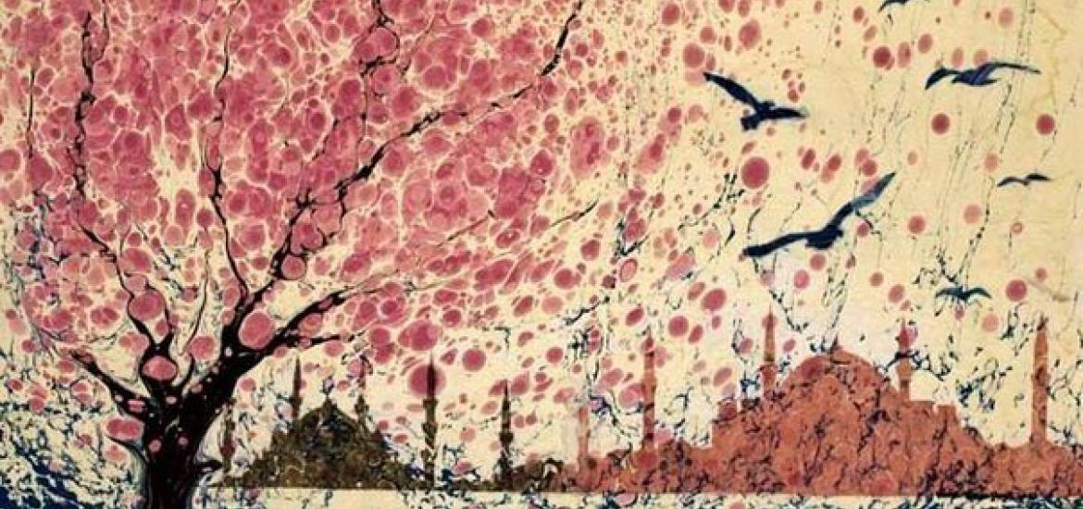
Dance Art and music
Ebru
Foklor (foklore)
Karagozle hacivat
Turku
Turkish art music
Turkish pop music
saz

Slide 8
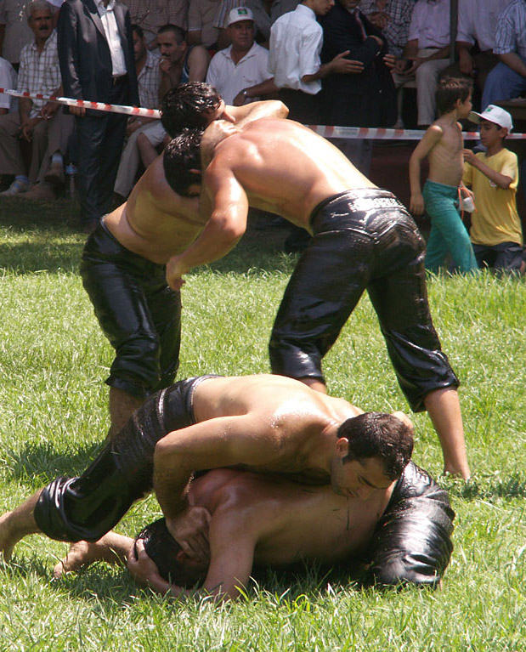
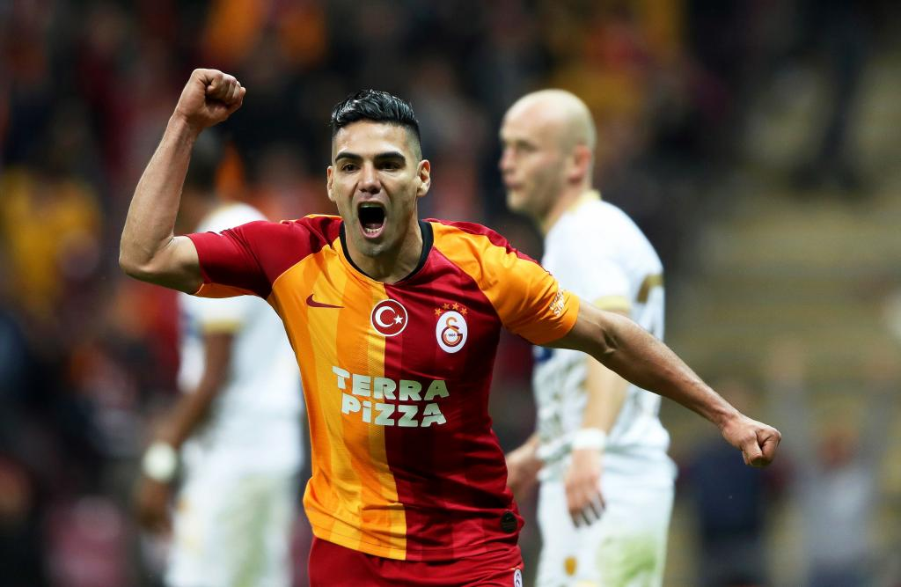
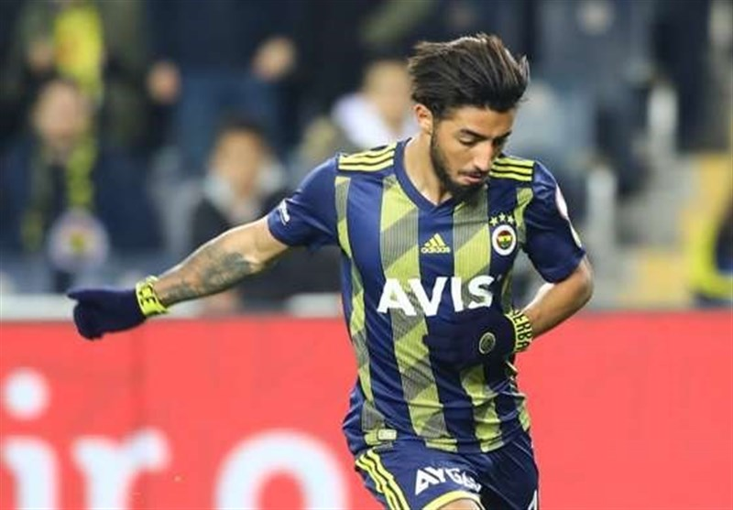
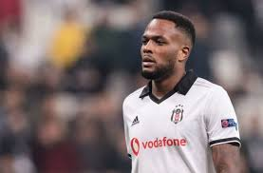
Games and Sports
Soccer (teams Galatasaray, Besiktas, Fenerbahçe.)
Oil wrestling
This Photo by Unknown Author is licensed under CC BY

Slide 9
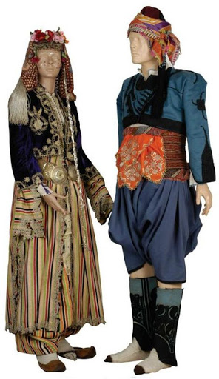
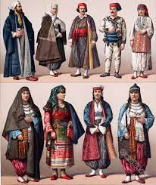
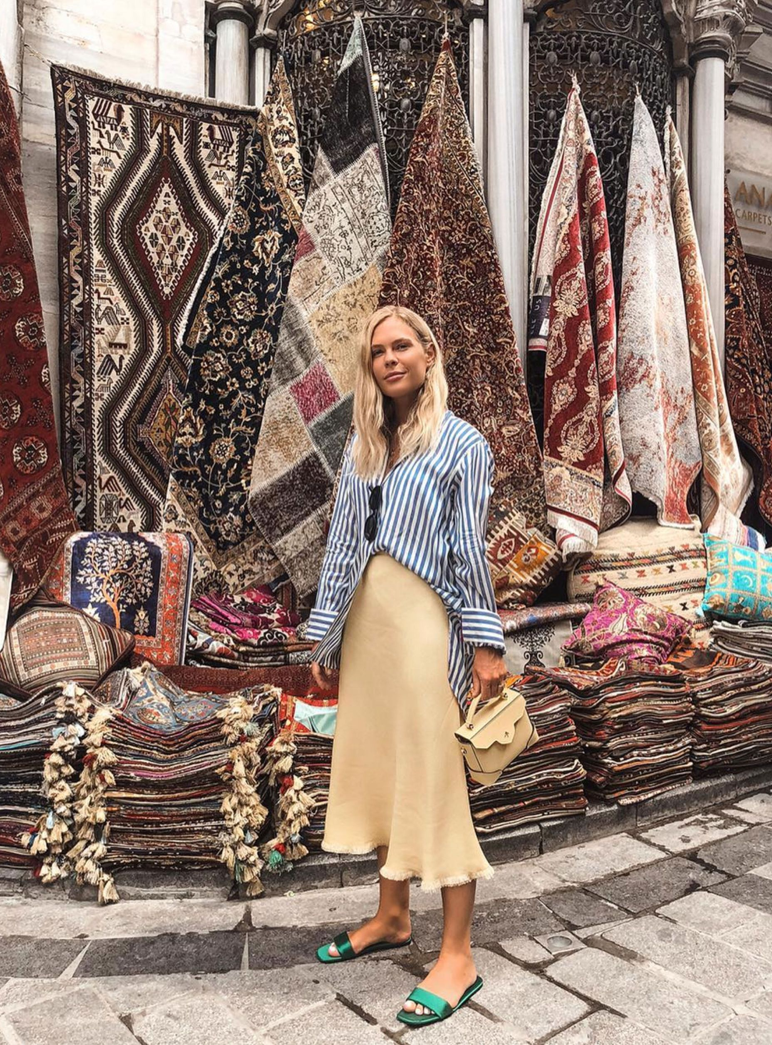
Turkey new, clothes and old clothes.
http://www.kostumcum.comimages/products/00/35/19/3519_kucuk.jpg

Slide 10
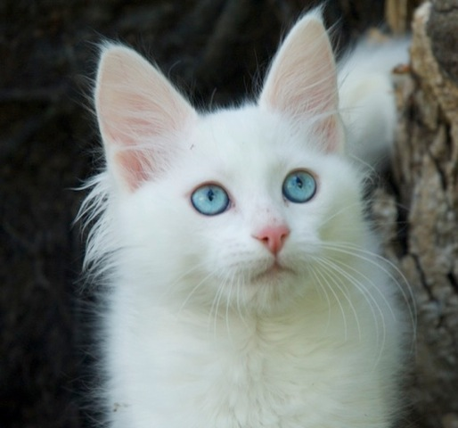
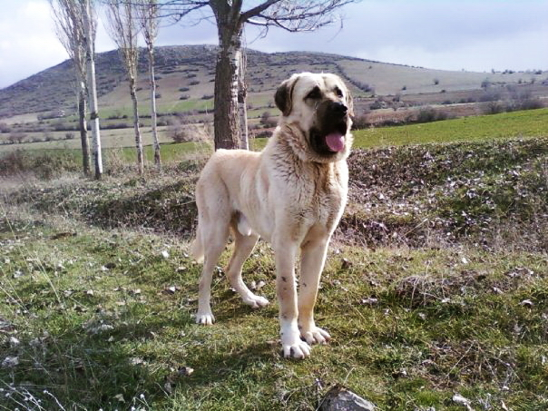
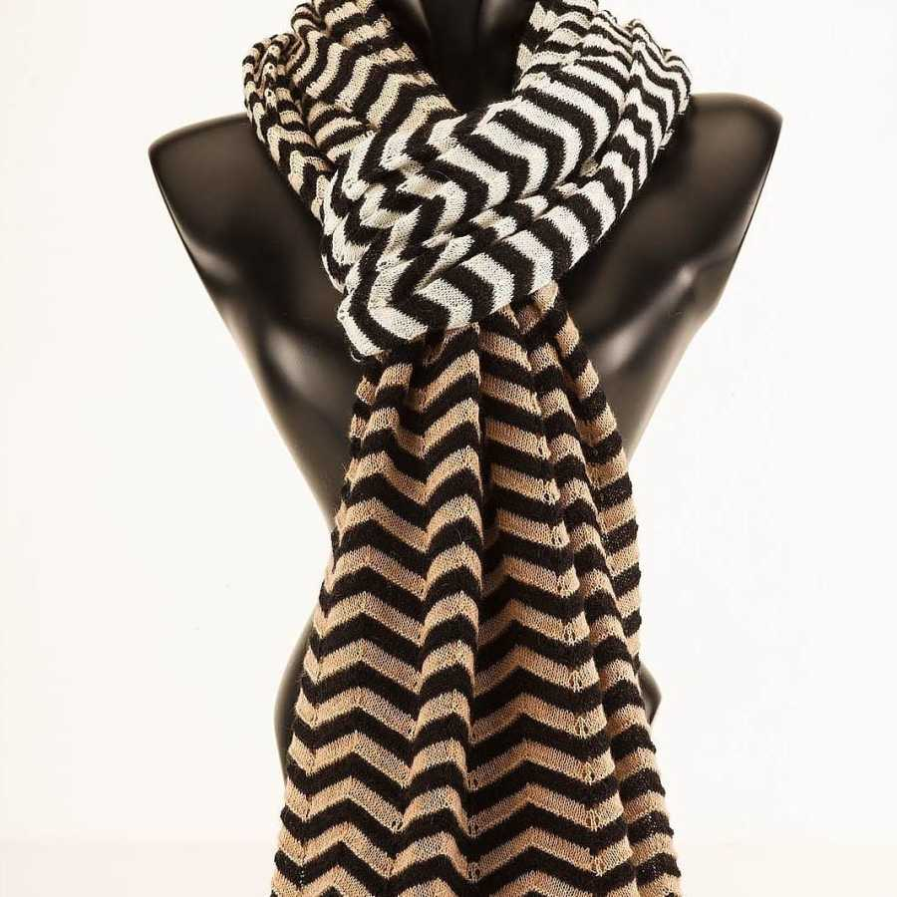
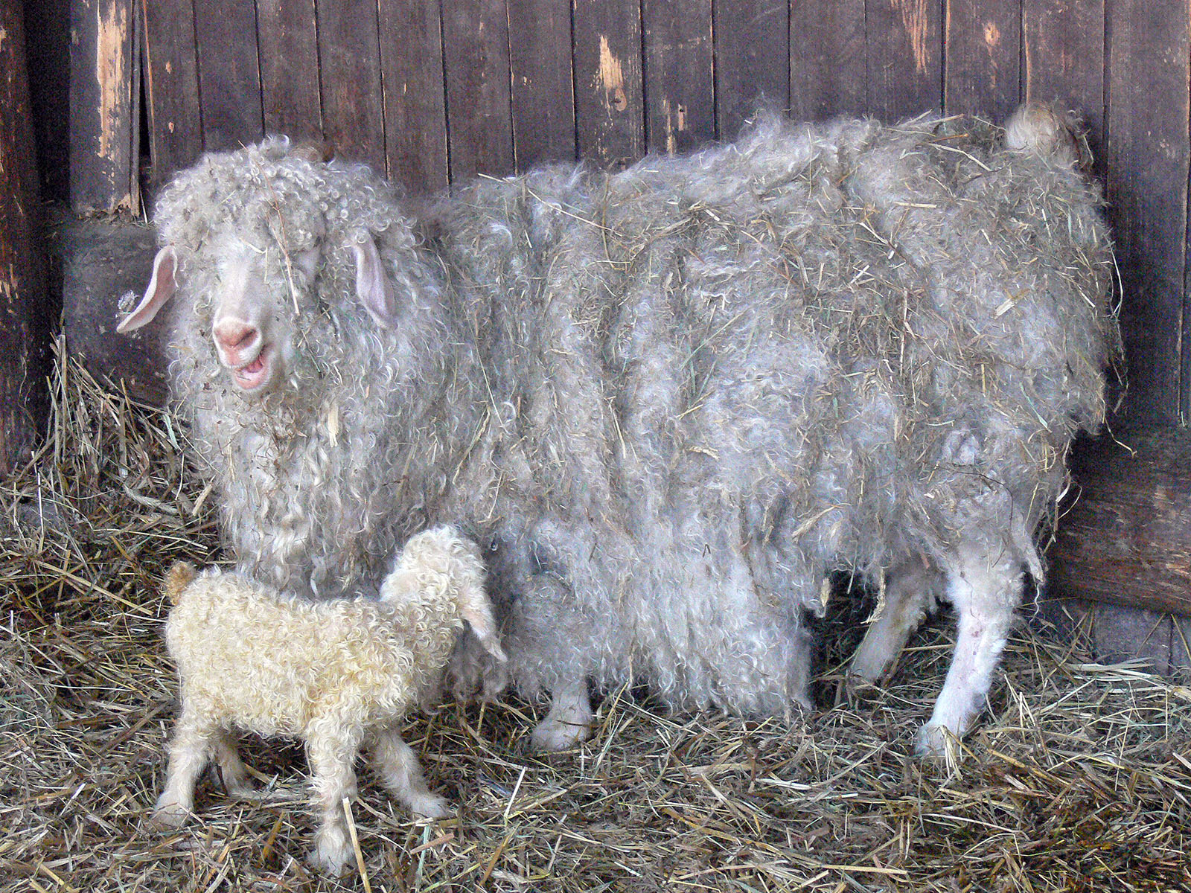
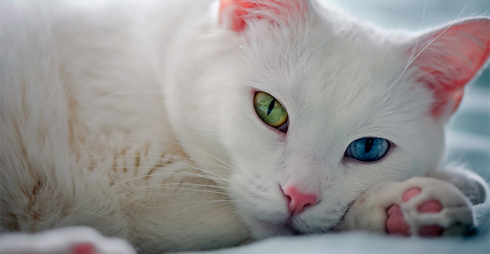
Turkish animals
Ankara cat
Kangal
Van cat
Ankara goat
Merinos
This scarf from Ankara goat

Slide 11
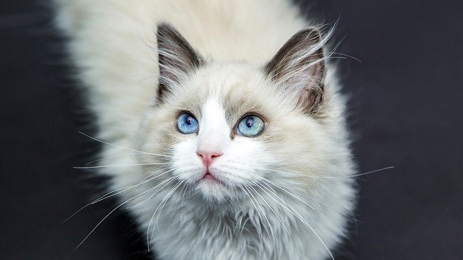
Thanks for listening.

